Slide 1






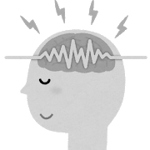

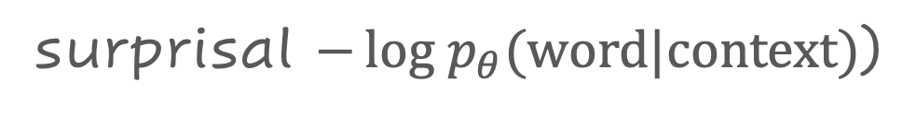
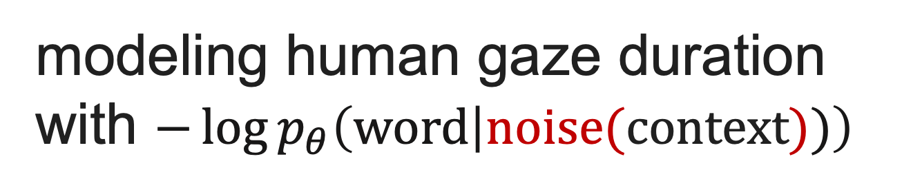
Context Limitations Make
Neural Language Models More Human-Like
Tatsuki Kuribayashi^{1,2}
Yohei Oseki^{3,4}
Ana Brassard^{1,4}
Kentaro Inui^{1,4}
¹Tohoku University
²Langsmith
³University of Tokyo
⁴RIKEN
Overview:
Are modern language models with powerful context access
(e.g., self-attention)
cognitively plausible?
Neural language models with limited context access successfully simulated human reading behavior
This corroborates the theory of human
(short-term) memory limitation during reading
↑paper
📚 Background: reverse-engineering human sentence processing
Investigated what metrics computed from what models can successfully explain human reading behavior
Humans’ expectation-based reading
[Levy`08][Smith&Levy`13]
Which model can compute human-like surprisal? Example:
Cognitive plausibility of models has been compared on various axes
text
surprisal $−log p_{θ}{(word|context)}$)
vanilla (sequential)
language model
models
model A
models
syntactic supervision
[Hale+`18][Yoshida+`21]…
model architecture/size
[Wilcox+`20][Merkx&Frank`21] …
training data size
[Wilcox+`20][Kuribayashi+`21]…
…
I have a pen that…
How
similar?
I know
grammar α
model B
better correlation
I have a pen that…
model C
Grammar β is likely
related to human
sentence processing
I have a pen that…
I know
grammar β
human gaze duration
This study: context limitation and cognitive plausibility of neural language models (LMs)
Does context limitation enhance
psychometric predictive power of LMs?
Why context access?
Transformer, LSTM…
… people wearing a red hat come…
modeling human gaze duration with $−\log{p_{θ}\left(word | noise(context))\right)}$
📚
LMs w/ powerful context access
are used in cognitive modeling [Wilcox+`20,`21][Merkx&Frank`21][Kuribayashi+`21]
… people wearing a red hat come …
🤔 Gap
… people wearing a red hat come …
compared n-gram surprisal
with different n as a first step
📚
Psycholinguistics suggested humans’ limited context use during reading [Lewis+`06][Futrell+`20]…
lossy context
Results: context limitation enhanced LMs‘ cognitive plausibility
Context limitation was significantly effective
across languages
Long/short context mattered in specific constructions
🤔 modern LMs might access too much context than humans
🤔 selective syntactic context will be needed to fill the gap
English
E.g., GPT2
English
significant divergence
Each line corresponds to each architecture
long context
advantage
Japanese results are also in our paper
better
gaze duration
modeling
🔍 reported how much squared residual errors decrease from 2-gram to
full-context
🔍 reported per-word
Δlog likelihood
between two nested regression models
w/ and w/o surprisal feature
full intra-sentential
context
2-gram
Japanese
More severe noise
🤔 Take-home messages
Revisiting memory-based theories on sentence processing with NLP tools is timely and interesting [Futrell+`20][Merkx+`21]
Successful solutions in NLP are not always cognitively
plausible; uncovering the mechanism of human language
processing is also this community’s pivotal issue

